Slide 1
LuxyRide
Presented by :
AKSHAY KUMAR SHARMA

Slide 2
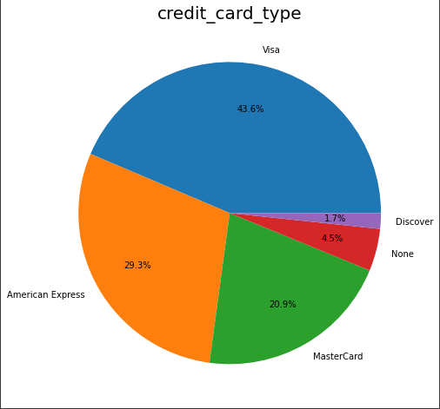
Credit Card Types AND THEIR IMPACTS
 | Master Card | American Express | Visa | Discover
Count | 1836 | 2484 | 3712 | 148
Mean Profit | 24.92 | 24.92 | 24.54 | 24.85
Profit | 45764.87 | 61905.95 | 91143.07 | 3678.80
Profit After Cashback | 38762.52 | 61905.95 | 91143.07 | 3678.80

Slide 3
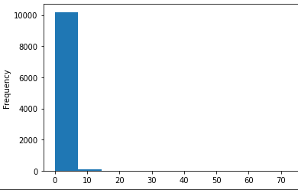
CASHBACK
We have given cashback as 2% of the customer_total to MasterCard users exculsively.
The entire cashback was paid out of our own Luxi Profit. The total amount we give in cashback is $ 7002.34.
99% of the cashbacks remain within $ 7 range and the mean is $ 3.8.
Only 0.87% of the cashbacks cross the $ 7 range.

Slide 4
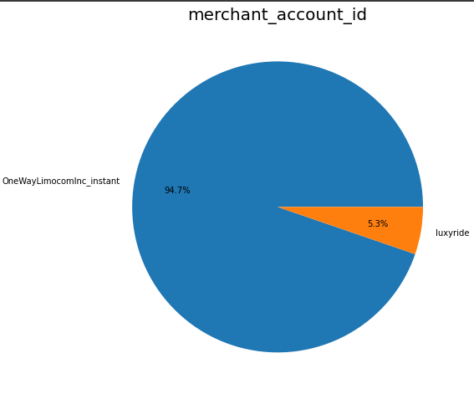
Merchant acc. id and its components

Slide 5
Profit Dependencies
Our profit that is denoted by Luxi Profit is mainly dependent on a few factors :-
gratuity_price - 42.84
affiliate_gratuity_price - 43.06
affiliate_processing_fee - 72.44
affiliate_trip_price - 66.79
We utilized 17% of the total gratuity price to boost our profit up.

Slide 6
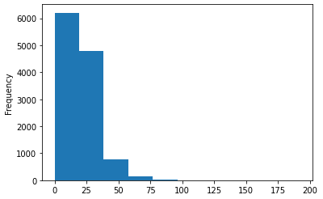
Gratuity Price
Gratuity Price has most of its values between 0 and 25.
Thus even if we take 18% of its total value we will be getting an average of $ 4-5 .
Same for the affiliate gratuity price.

Slide 7
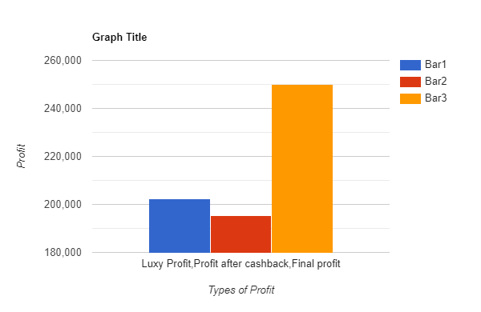
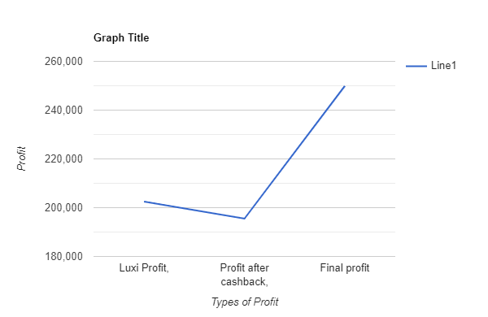
Final profit

Slide 8
Final Comparison
 | Before Cash back | After Cash back to MasterCard | After Final Changes of 0.17%
Profit | 202492.69 | 195490.3494 | 249894.34
Profit Percentage | 13.016 | 12.57 | 16.06

Slide 9
THANK YOU

